Slide 1
Digital Classroom
Project Presentation
Date:5-April-2024
Presented by: Jatin &Karan Bhardwaj
Project Mentor: Mrs Himani
Education & Training Division (ETD) Centre for Development of Advanced Computing (C-DAC) (Ministry of Electronics & Information Technology, Govt. of India) A-34, Phase-VIII, Industrial Area, Mohali (160071)

Slide 2
Table of Contents
Introduction
Problem statement
Objective
Design Methodology
Results – Front end clips, back end design clips, data base etc.
Conclusion or Future Scope
References

Slide 3
Introduction
Digital Classroom is a free service that allows you to share files, create assignments, grade assignments and communicate with your students in a paperless way.
A digital classroom is a learning environment that leverages technology to enhance student engagement, collaboration, and access to information. It can encompass both physical and virtual spaces.

Slide 4
Problem Statement
The traditional classroom often lacks personalization and engagement, while teachers struggle with managing tasks. This digital classroom project tackles these issues by using quizzes and activities to personalize learning, boost student motivation, and streamline administrative processes for teachers, ultimately creating a more effective and accessible learning environment for all.

Slide 5
Objective or Problem Formulation
Student Perspective:
Enhance Learning:
Promote deeper understanding through interactive elements, multimedia resources, and diverse learning materials.
Improve Accessibility:
Allow students to learn anytime, anywhere with on-demand learning materials and remote access.

Slide 6
Objective or Problem Formulation
Teacher Perspective
Boost Student Achievement:
Utilize data and assessments to personalize instruction and track student progress effectively.
Create a Rich Learning Environment:
Integrate various media and technology tools to enhance traditional lessons.
Efficiently Manage Resources:
Utilize digital tools for assignments, feedback, and communication, saving time and resources.

Slide 7
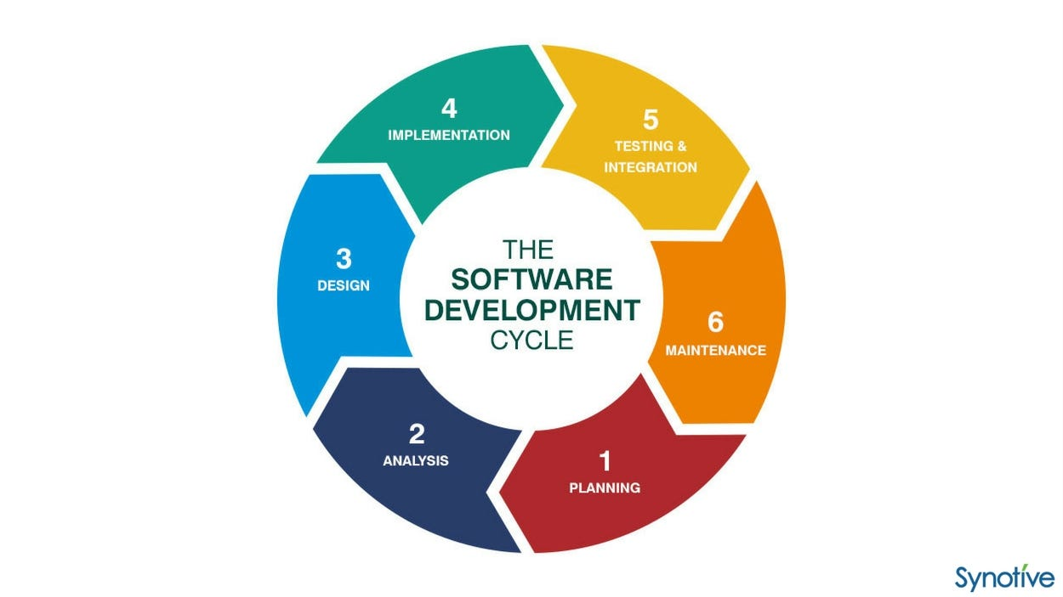
Design Methodology
Software Development Life Cycle

Slide 8
Project Explanation
User Authentication Module:
Dashboard Module:
Class Management Module:
Assignment Management Module:
Communication Module:

Slide 9
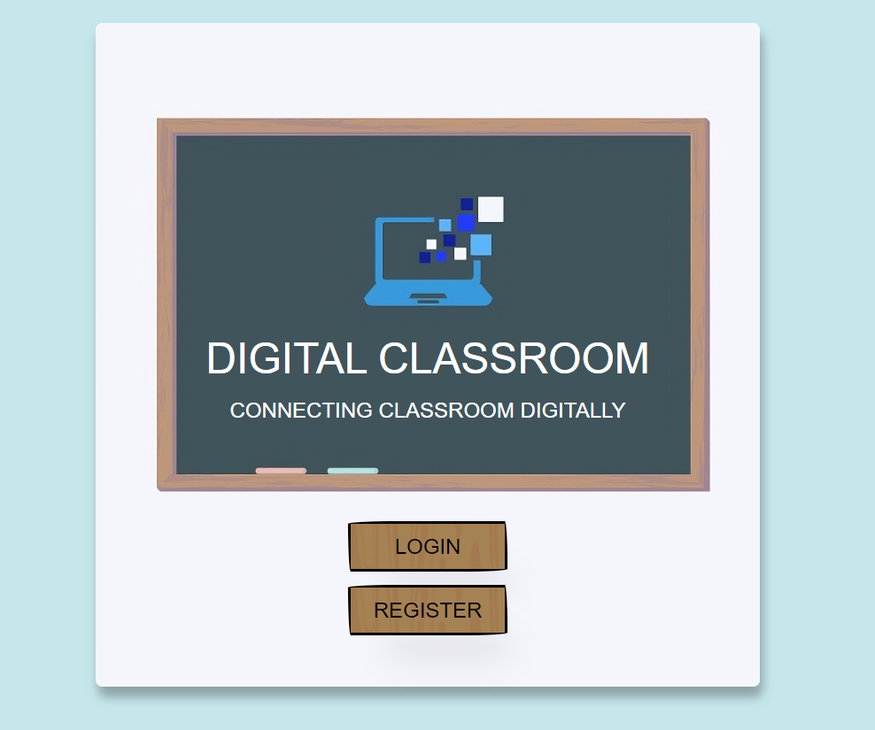
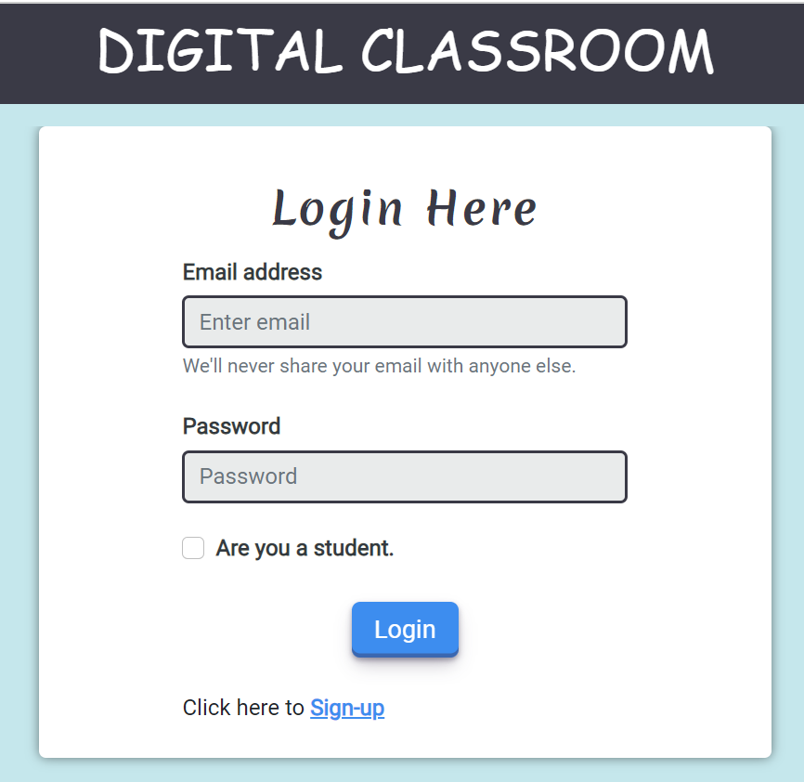
Results

Slide 10
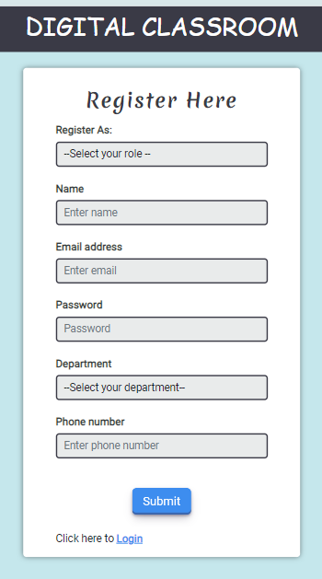
RESULTS

Slide 11
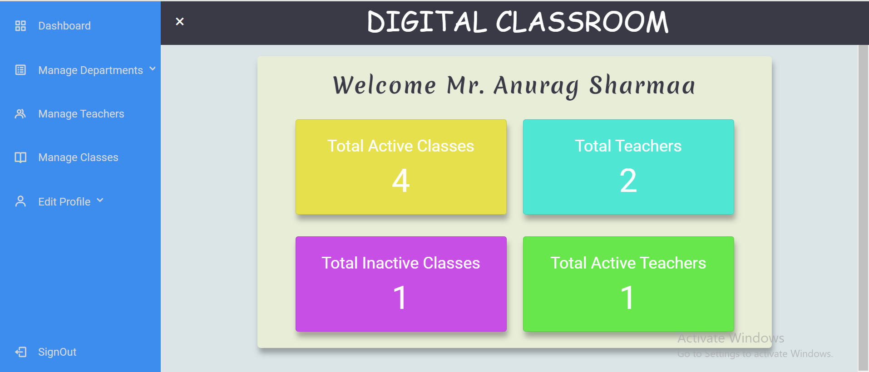
RESULTS

Slide 12
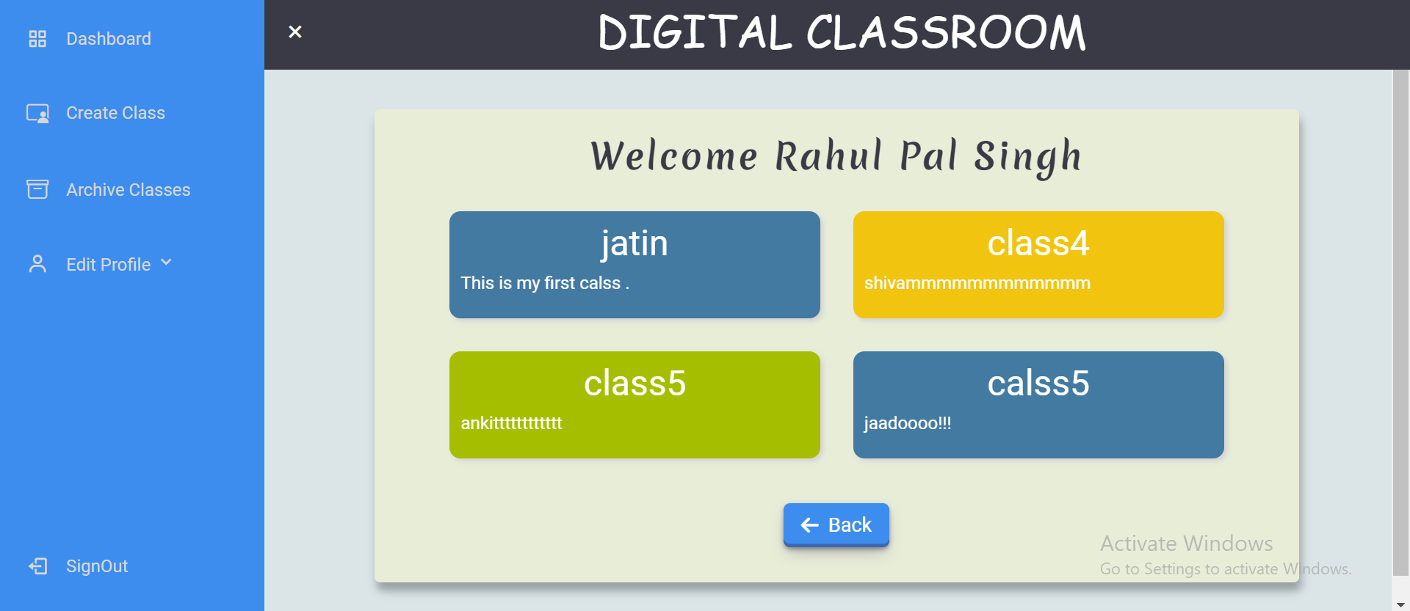
RESULTS

Slide 13
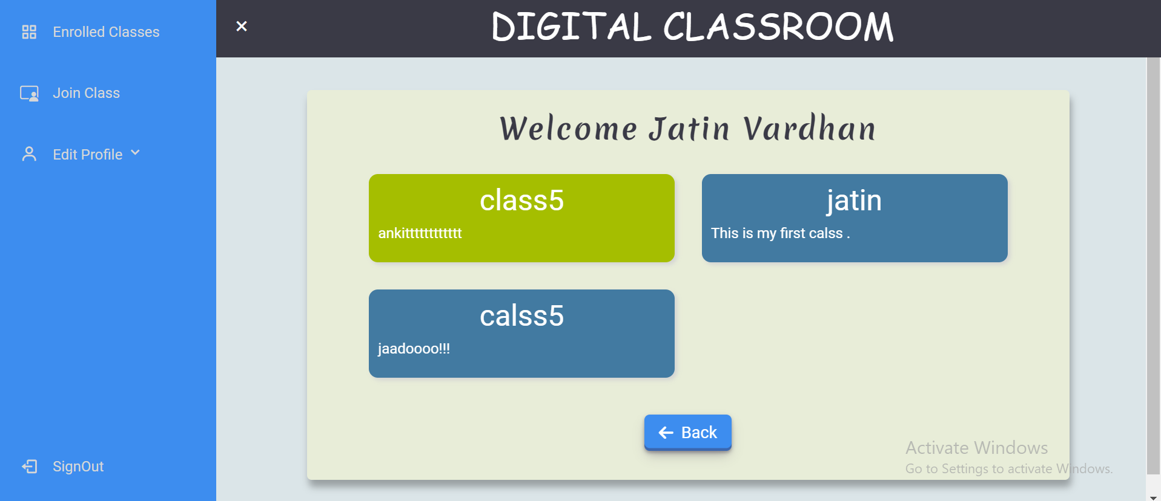
RESULTS

Slide 14
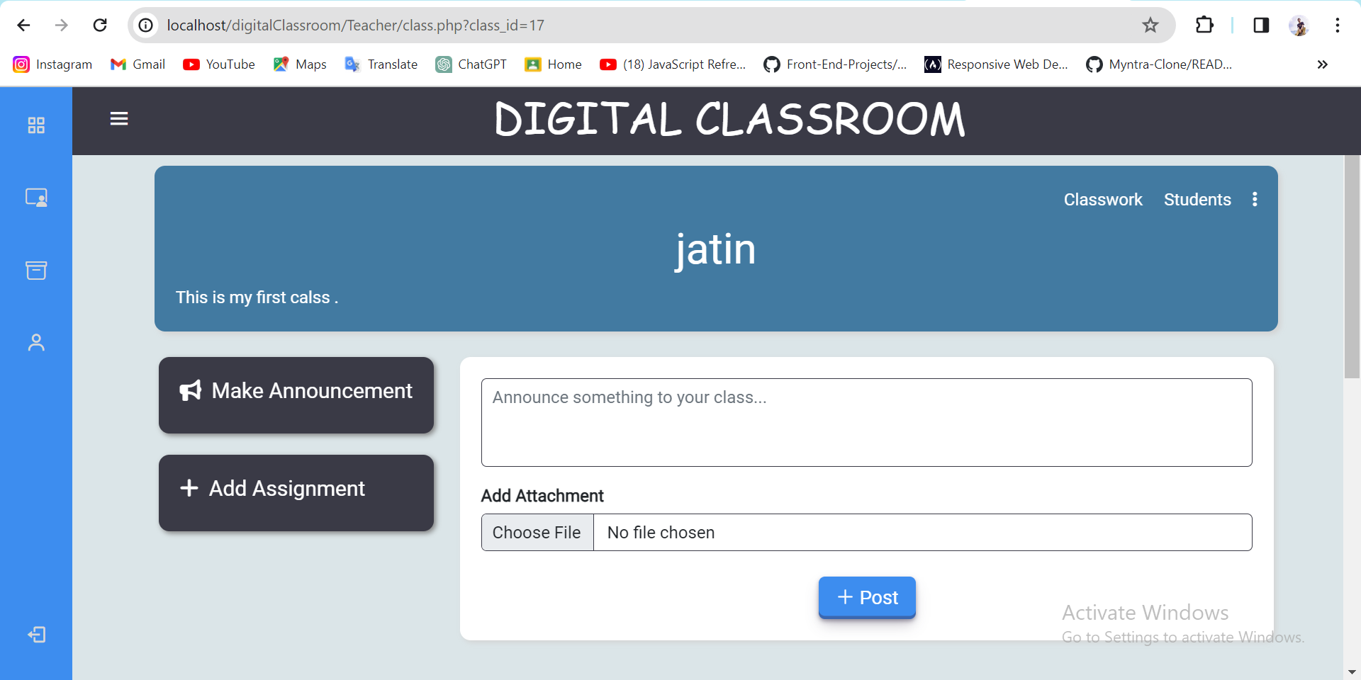
RESULTS

Slide 15
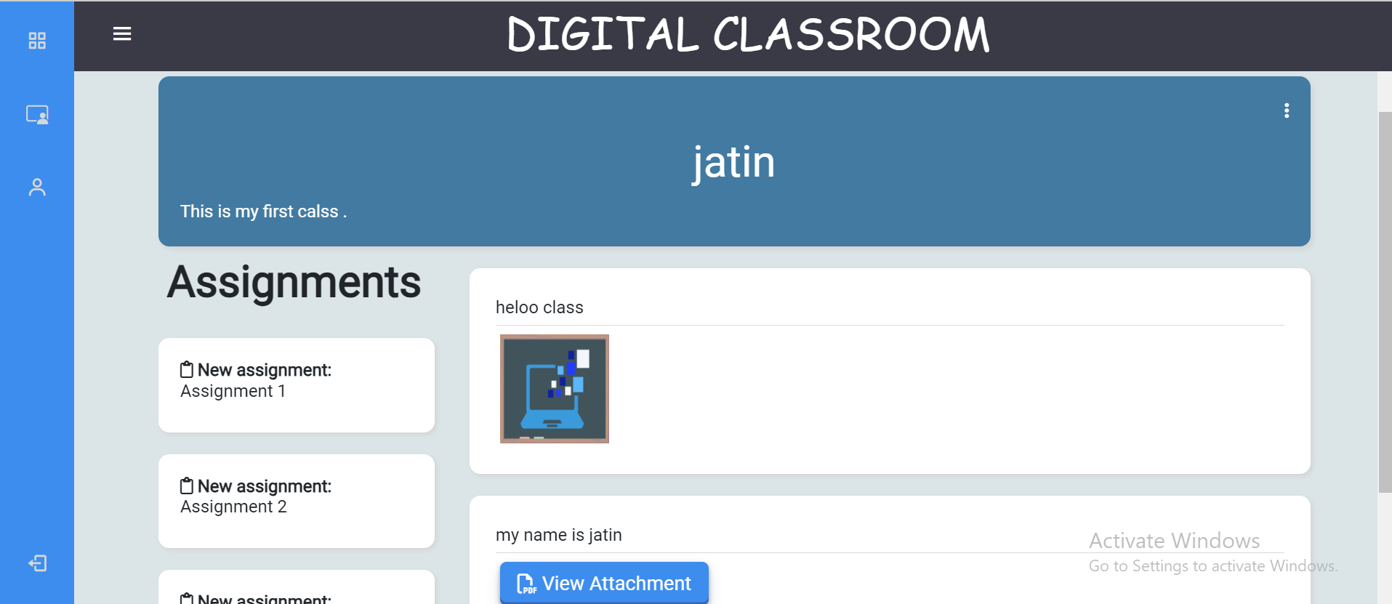
RESULTS

Slide 16
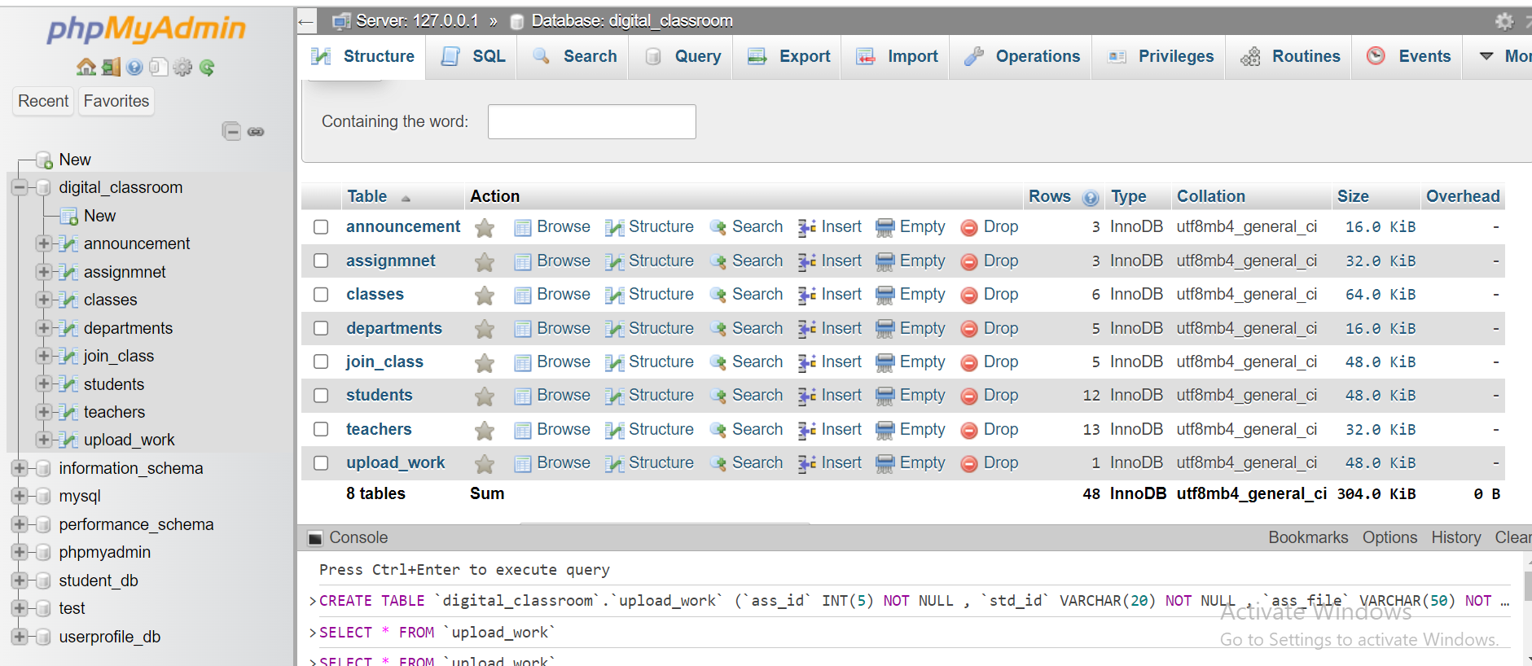
RESULTS

Slide 17
FUTURE SCOPE & Conclusion
Enhanced Features
Tracks student attendance, participation in discussions, and quiz performance to personalize the learning path and provide targeted support.
Chatbot
Provide a virtual assistant to answer basic questions, offer resources, and guide students even outside class hours.
Global Collaboration
Integrate features like video conferencing, group projects, and online forums to foster collaboration among students worldwide.
Connecting Student Digitally This digital classroom simplifies lesson planning, tracks progress, and personalizes learning - all in one easy-to-use platform.

Slide 18
References
https://www.geeksforgeeks.
https://www.blackbox.ai/
https://www.w3schools.com/html/

